Slide 1
Tennis Ball Picker Upper
By: Ashley Levine

Slide 2
What is my Project?
Picking up tennis balls is time consuming and annoying
Having a machine that picks up the ball for you will not only prevent you from bending down and hurting your back, but will save you a lot of time
Will start off with a button and hopefully extend to an automatic machine
The machine knows when it gets close to the ball to pick it up
Senses the ball
I wanted to create this project because growing up and playing tennis, I was very lazy when it came to picking up the balls and it also was very time consuming.

Slide 3
3 Projects that Influenced Mine
https://www.youtube.com/watch?v=M0Ja_UNz0Rg
https://www.youtube.com/watch?feature=player_embedded&v=OhzrJpGD5jE
https://www.sparkfun.com/tutorials/258
http://www.retrobuiltgames.com/the-build-page/arduino-claw-machine/
https://www.hackster.io/-MMM-/homemade-claw-machine-0f26aa
https://www.youtube.com/watch?v=gDD7_KUIm58
All of these projects influenced me because I grew up being obsessed with the claw gameroom game and I would love to create something like that

Slide 4
What Parts I used
Two pieces of cardboard as the claw
TwoServo motor
Switch
LED
10 KILO OHM Resistor
220 OHM Resistor
1 Megohm Resistor
100uF Capacitor

Slide 5
Inputs and Outputs
Input- the button
Output- the servo motor/ claw

Slide 6
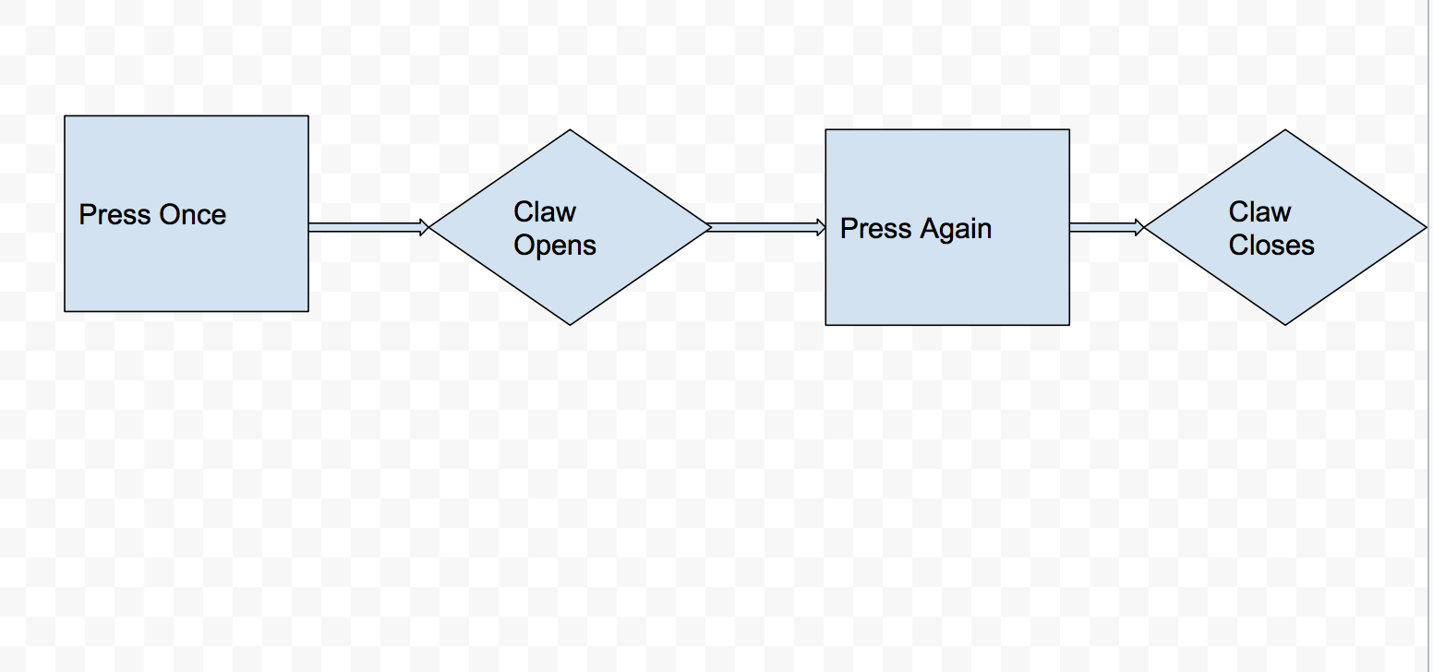
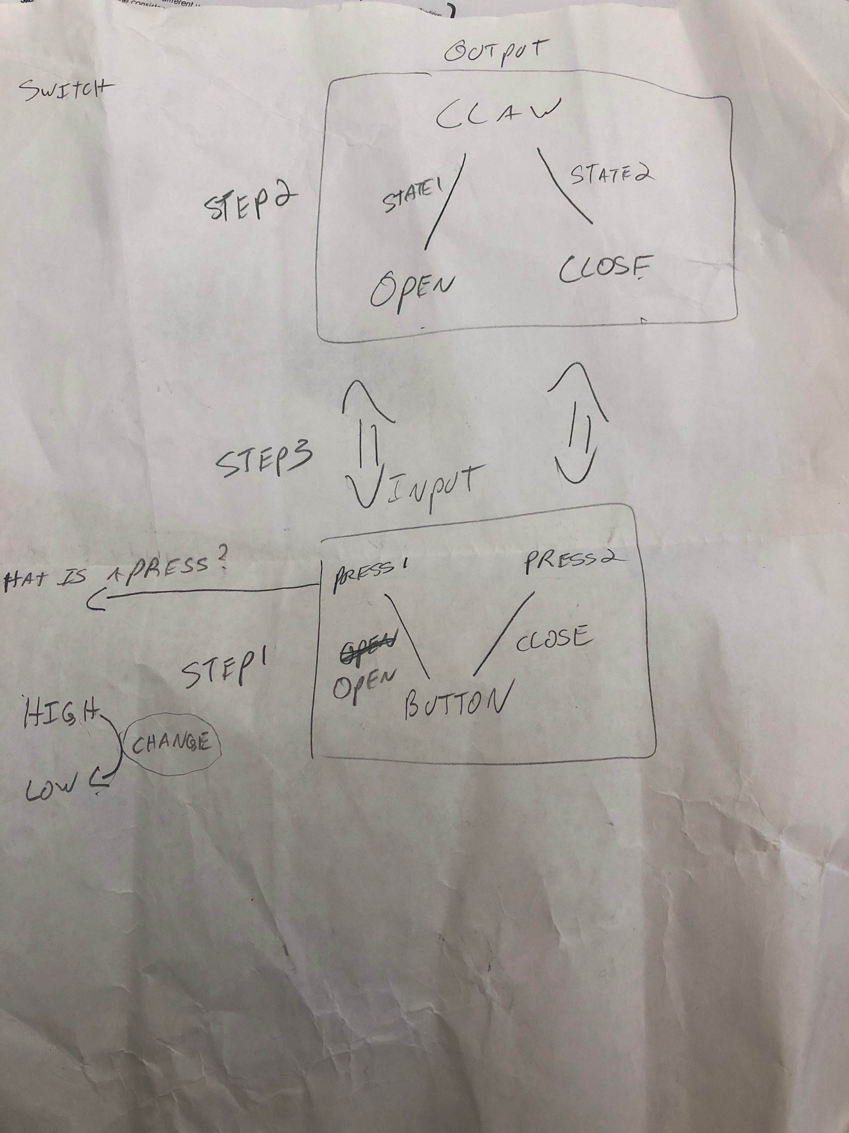
Interaction Explained
When you get close to a ball you want to pick you, the user will hit the button and the claw will pick up the ball for you
Flow Diagram-

Slide 7
Who are your Stakeholders?
People who play tennis

Slide 8
How does your program work? Code Explained
Reflection- I realized I was unable to get the machine to pick up a ball, but I was able to make the claw come together in the end after playing with the degrees on the servo.write in the code. I had to play with the numbers for both servo1.write and servo2.write to see how I could get the two to match up.
In the beginning, I could not figure out how to get the two claws to come together and I feel that was the hardest part.
If I had more time, I would find a way for the claw to be able to pick up something.

Slide 9
Side Notes
Noticed when I added the second servo, the first servo either went crazy or did not work. After it finally worked, I played with the degrees to see how the claw would match up.

Slide 10
Interaction
How a user interacts with the input/output- they hit the button and the claw opens and closes

Slide 11
How Project Is Used
The user hits the button to either close the claw or hits again to open the claw
User presses button- claw opens
User presses button- claw closes

Slide 12
Talk about what form factor/size your project would ideally be
Ideally I would have a robot that has these claws on it that would pick up the tennis balls

